Slide 1
Programming II
(C Programming Language)
Basic Syntax, C Data Types, and C Environment Setup
Lecture 2, Wednesday January 27, 2021
Dr. Ayman ALJARBOUH

Slide 2
Outline
C Basic Syntax
C Data Types
Escape Sequences & Conversion Specification
Displaying Multiple Lines and Variable Values
C Environment Setup

Slide 3
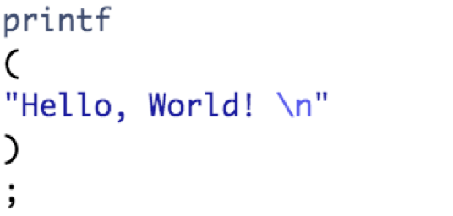
C Basic Syntax: Tokens in C
A C program consists of various tokens
A token is either a keyword, an identifier, a constant, a string literal, or a symbol
For example, the following C statement consists of five tokens
The individual tokens are:

Slide 4
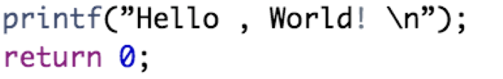
C Basic Syntax: Semicolons (;)
In C program, the semicolon is a statement terminator
Each individual statement must be ended with a semicolon
A semicolon indicates the end of one logical entity
For example, following are two different statements:

Slide 5
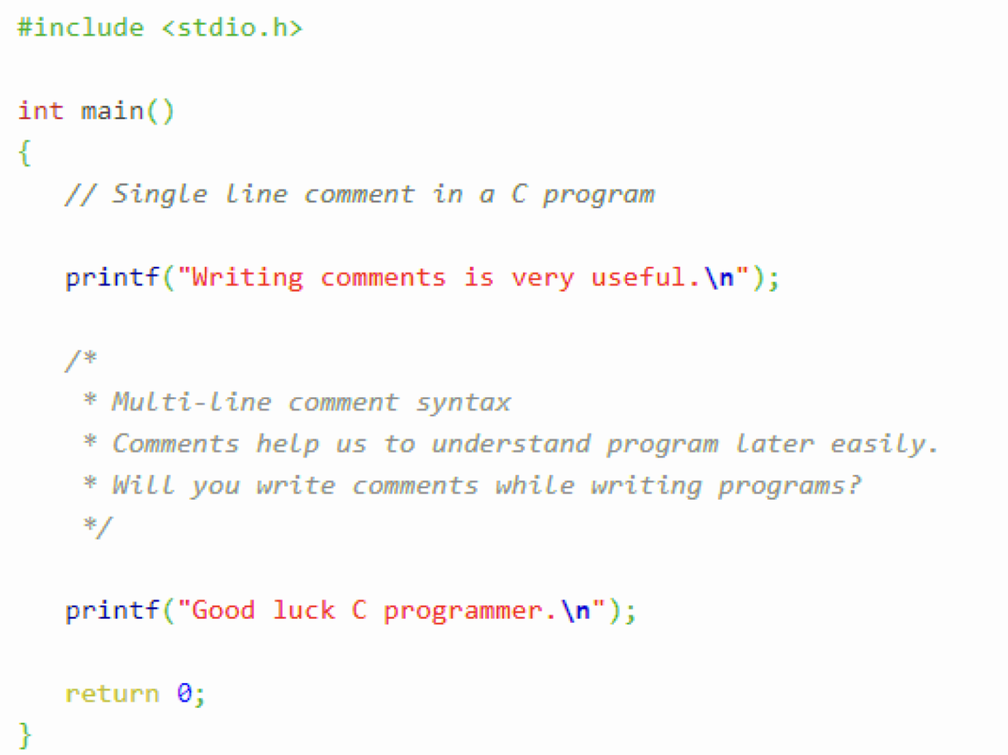
C Basic Syntax: Comments
Comments are ignored by the compiler. Multi-line comments start with /* and terminate with */ while single-line comments are preceded by two forward slashes //

Slide 6
C Basic Syntax: Identifiers
A C identifier is a name used to identify a variable, function, or any other user-defined item
An identifier starts with a letter A to Z or a to z or an underscore followed by zero or more letters, underscores, and digits (0 to 9)
C does not allow punctuation characters such as @, $, and % within identifiers
Identifier names must be different from keywords
Here are some examples of acceptable identifiers:
An identifier should never start with a digit

Slide 7
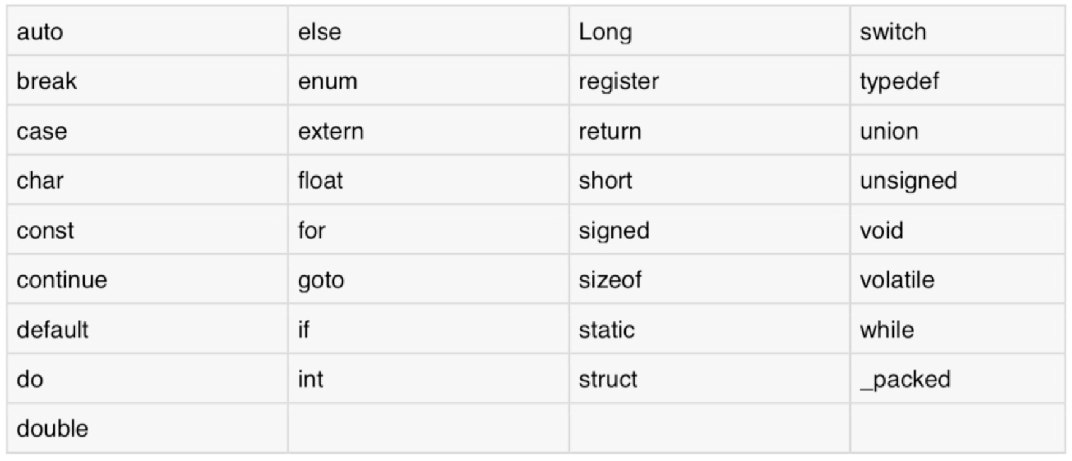
C Basic Syntax: Keywords
Keywords are predefined and reserved words in C
All keywords must be written in lowercase
Here is a list of keywords that are used in C:

Slide 8

C Basic Syntax: Whitespace in C
C compiler totally ignores whitespace
A whitespace describes blanks, tabs, newline characters and comments
Whitespace separates one part of a statement from another
Examples:
In this statement, there should be one whitespace character between int and age for the compiler to be able to distinguish them

Slide 9
Outline
C Basic Syntax
C Data Types
Escape Sequences & Conversion Specification
Displaying Multiple Lines and Variable Values
C Environment Setup

Slide 10
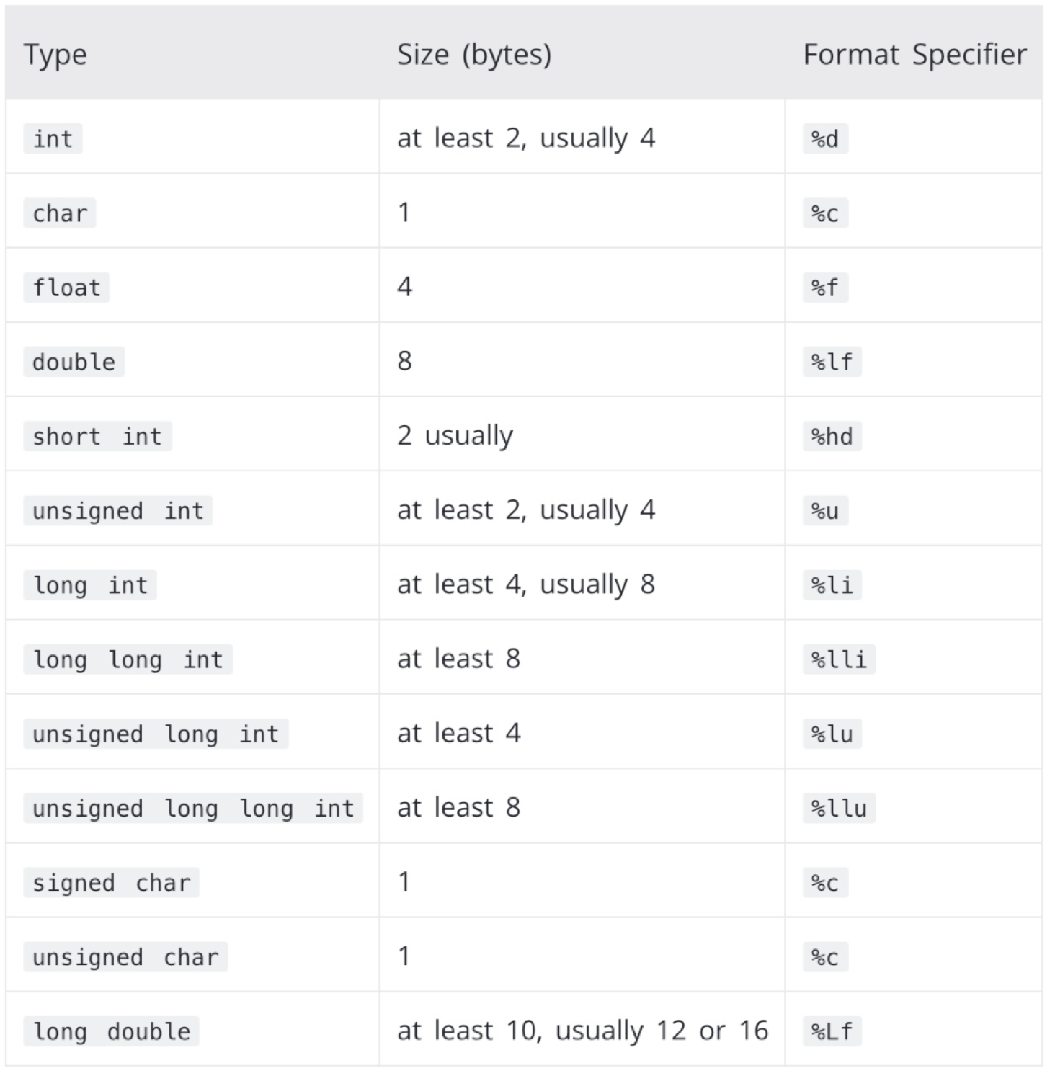


C Data Types
Data types are declarations for variables
Integer Type:
Integers have no decimal values (eg. 0, -5, 10)
We use the keyword int for integer declaration
For example:
The size of int is 4 bytes

Slide 11

C Data Types
Data types are declarations for variables
Float & Double Type:
Float and double are used to hold real numbers
We use the keywords float and double for declaration
For example:
The size of float is 4 bytes and the size of double is 8 bytes and

Slide 12

C Data Types
Data types are declarations for variables
Char Type:
We use the keywords char for character declaration
For example:
The size of char is 1 byte

Slide 13
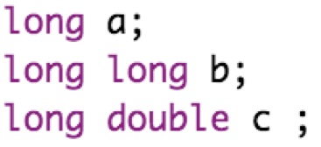
C Data Types
Data types are declarations for variables
Short & Long Types:
If only a small integer [−32767, +32767] is used, you can use short int
If a large integer is used, you can use long
For example:

Slide 14
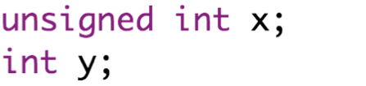
C Data Types
Data types are declarations for variables
Signed & Unsigned Types:
You can use unsigned to declare variables holding only zero and positive
For example:

Slide 15
C Data Types
Data types are declarations for variables
Void Type:
The type void is means “nothing” or “no type
If a function is not returning anything, its return type should be void
Note that, you cannot create variables of void type

Slide 16
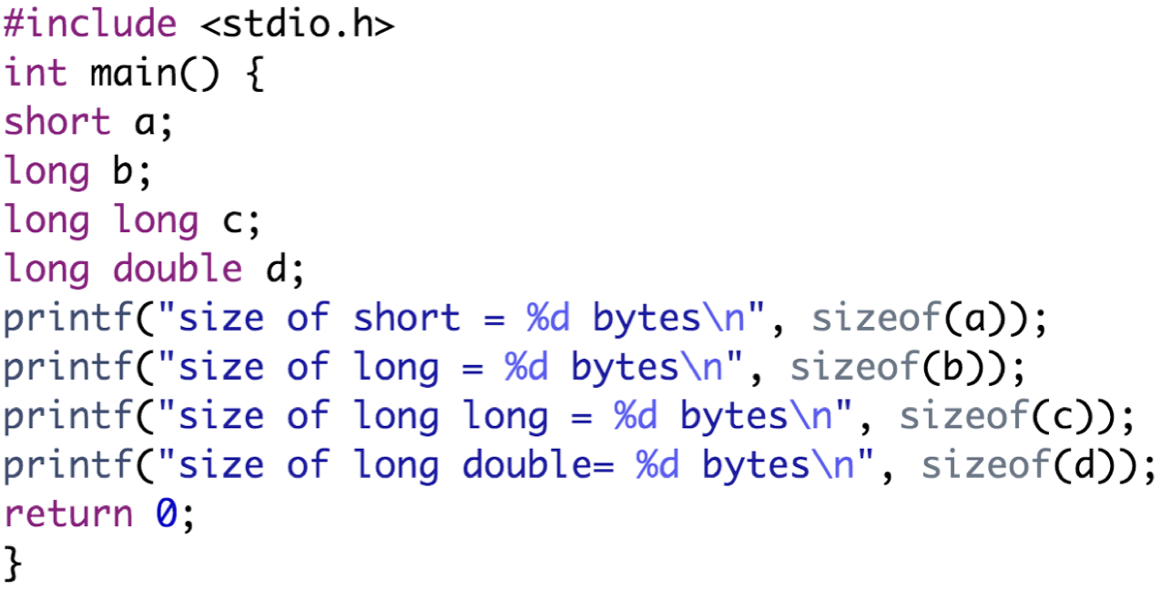
C Data Types
You can always check the size of a variable using sizeof()
Example:

Slide 17
Outline
C Basic Syntax
C Data Types
Escape Sequences & Conversion Specification
Displaying Multiple Lines and Variable Values
C Environment Setup

Slide 18
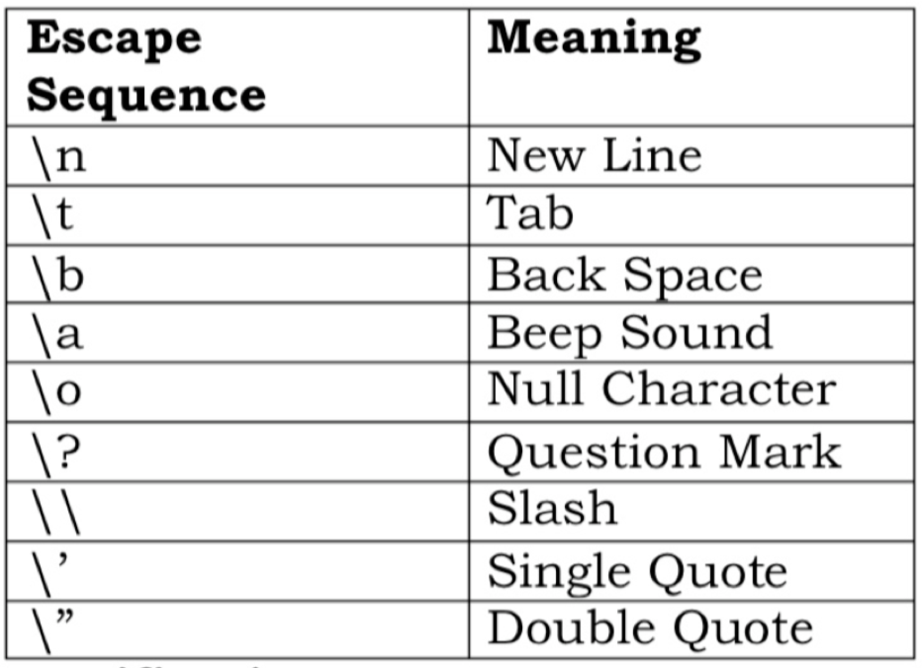
Escape Sequences
Non graphic characters that cannot be typed directly from keyboard
Represented by a backslash followed by one or more characters
An escape sequence consumes only 1 byte of space as it represents a single character

Slide 19
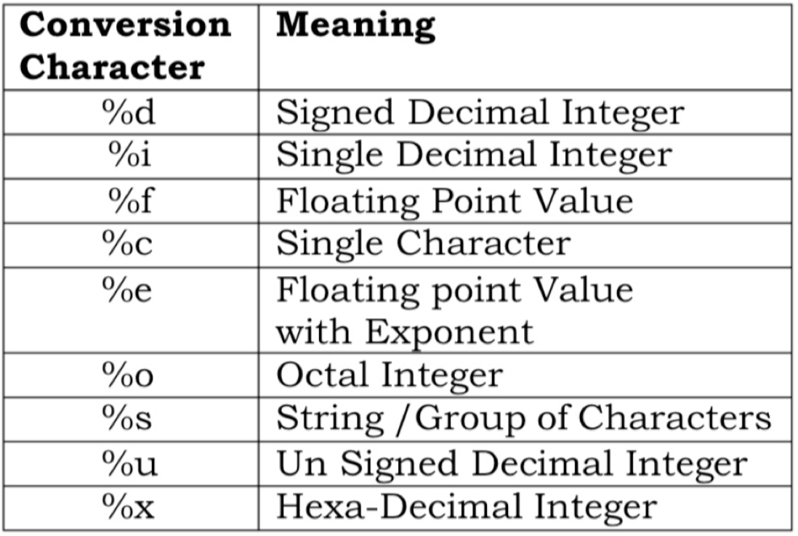
Format Specifier
Format specification is also a pair of character
It is preceded by % and followed by a quote which may be a character

Slide 20
Outline
C Basic Syntax
C Data Types
Escape Sequences & Conversion Specification
Displaying Multiple Lines and Variable Values
C Environment Setup

Slide 21
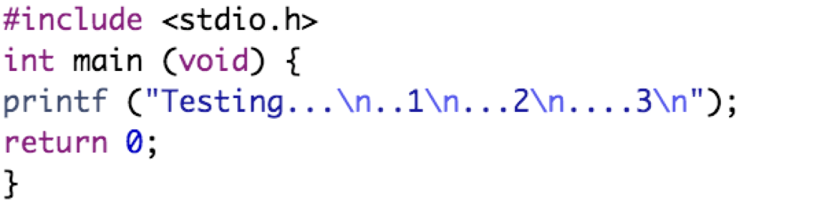
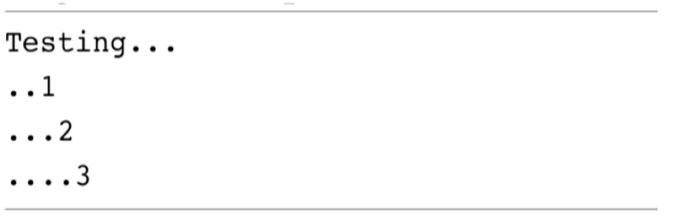
Displaying Multiple Lines of Output
You can use a single printf function to print multiple lines of output
Example:
Output:

Slide 22
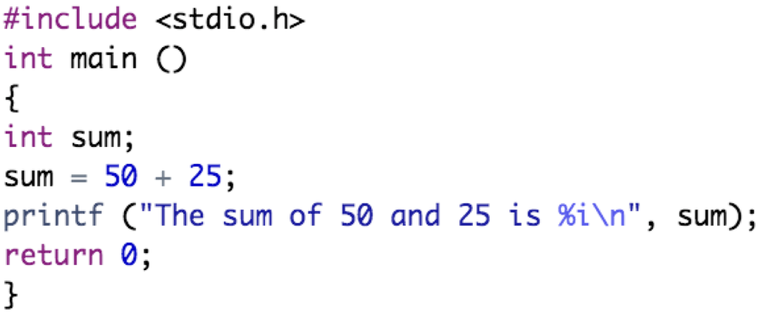

Displaying the Values of Variables
The printf function can display values of variables
Example:
The first statement declares the variable sum to be of type integer

Slide 23

Displaying the Values of Variables
The printf function can display values of variables
Example:
The number 50 is added 25, and the result is stored in the variable sum.

Slide 24
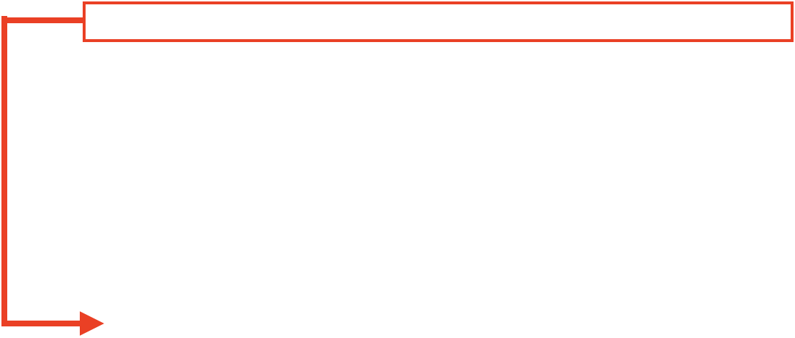
Displaying the Values of Variables
The printf function can display values of variables
Example:
Because sum is an integer variable and next to printf, its value is automatically displayed after the characters “The sum of 50 and 25 is” are displayed

Slide 25
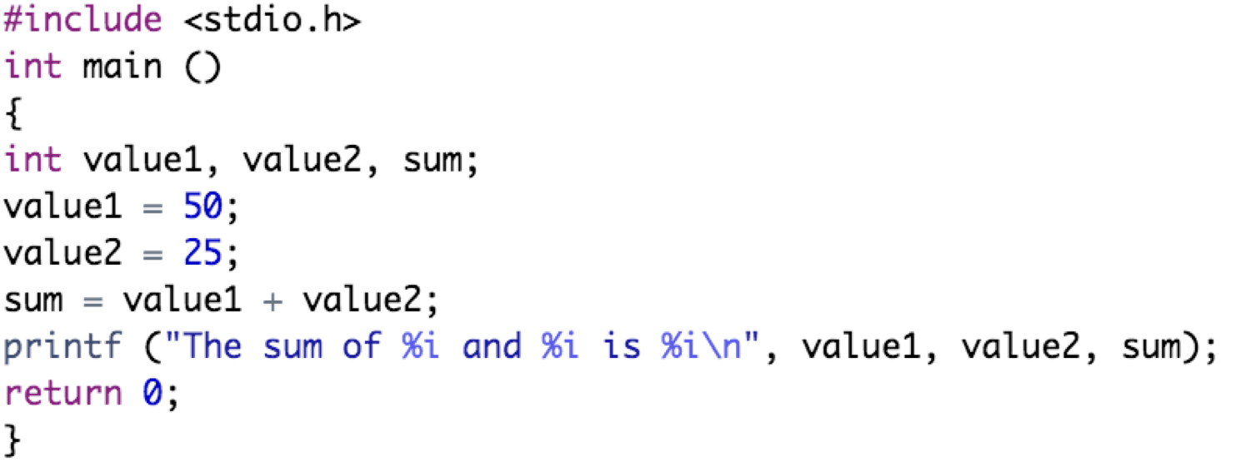
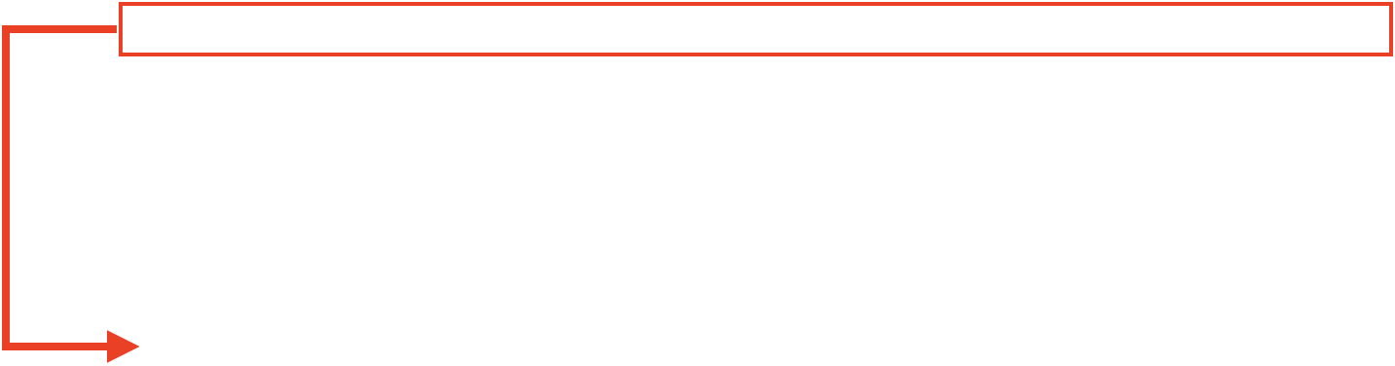
Displaying the Values of Variables
It is also possible to display multiple values
Example:
The value of the variable value1 is to be displayed immediately following the display of the characters “The sum of”. Similarly, the values of the variables value2 and sum are to be printed at the appropriate points, as indicated by the next two occurrences of the %i characters

Slide 26
Outline
C Basic Syntax
C Data Types
Escape Sequences & Conversion Specification
Displaying Multiple Lines and Variable Values
C Environment Setup

Slide 27
C Environment Setup
You need two software on your computer. A C text editor and a C compiler
Text Editor:
Examples of few text editors include Windows Notepad, OS Edit command, Brief, Epsilon, EMACS, and vim or vi
The source files for C programs are named with extension “.c”
Compiler:
The compiler is used to compile the source code into executable program
Most frequently used and free available compiler is GNU C/C++ compiler

Slide 28
C Environment Setup
You need two software on your computer. A C text editor and a C compiler
Text Editor:
Examples of few text editors include Windows Notepad, OS Edit command, Brief, Epsilon, EMACS, and vim or vi
The source files for C programs are named with extension “.c”
Compiler:
The compiler is used to compile the source code into executable program
Most frequently used and free available compiler is GNU C/C++ compiler

Slide 29
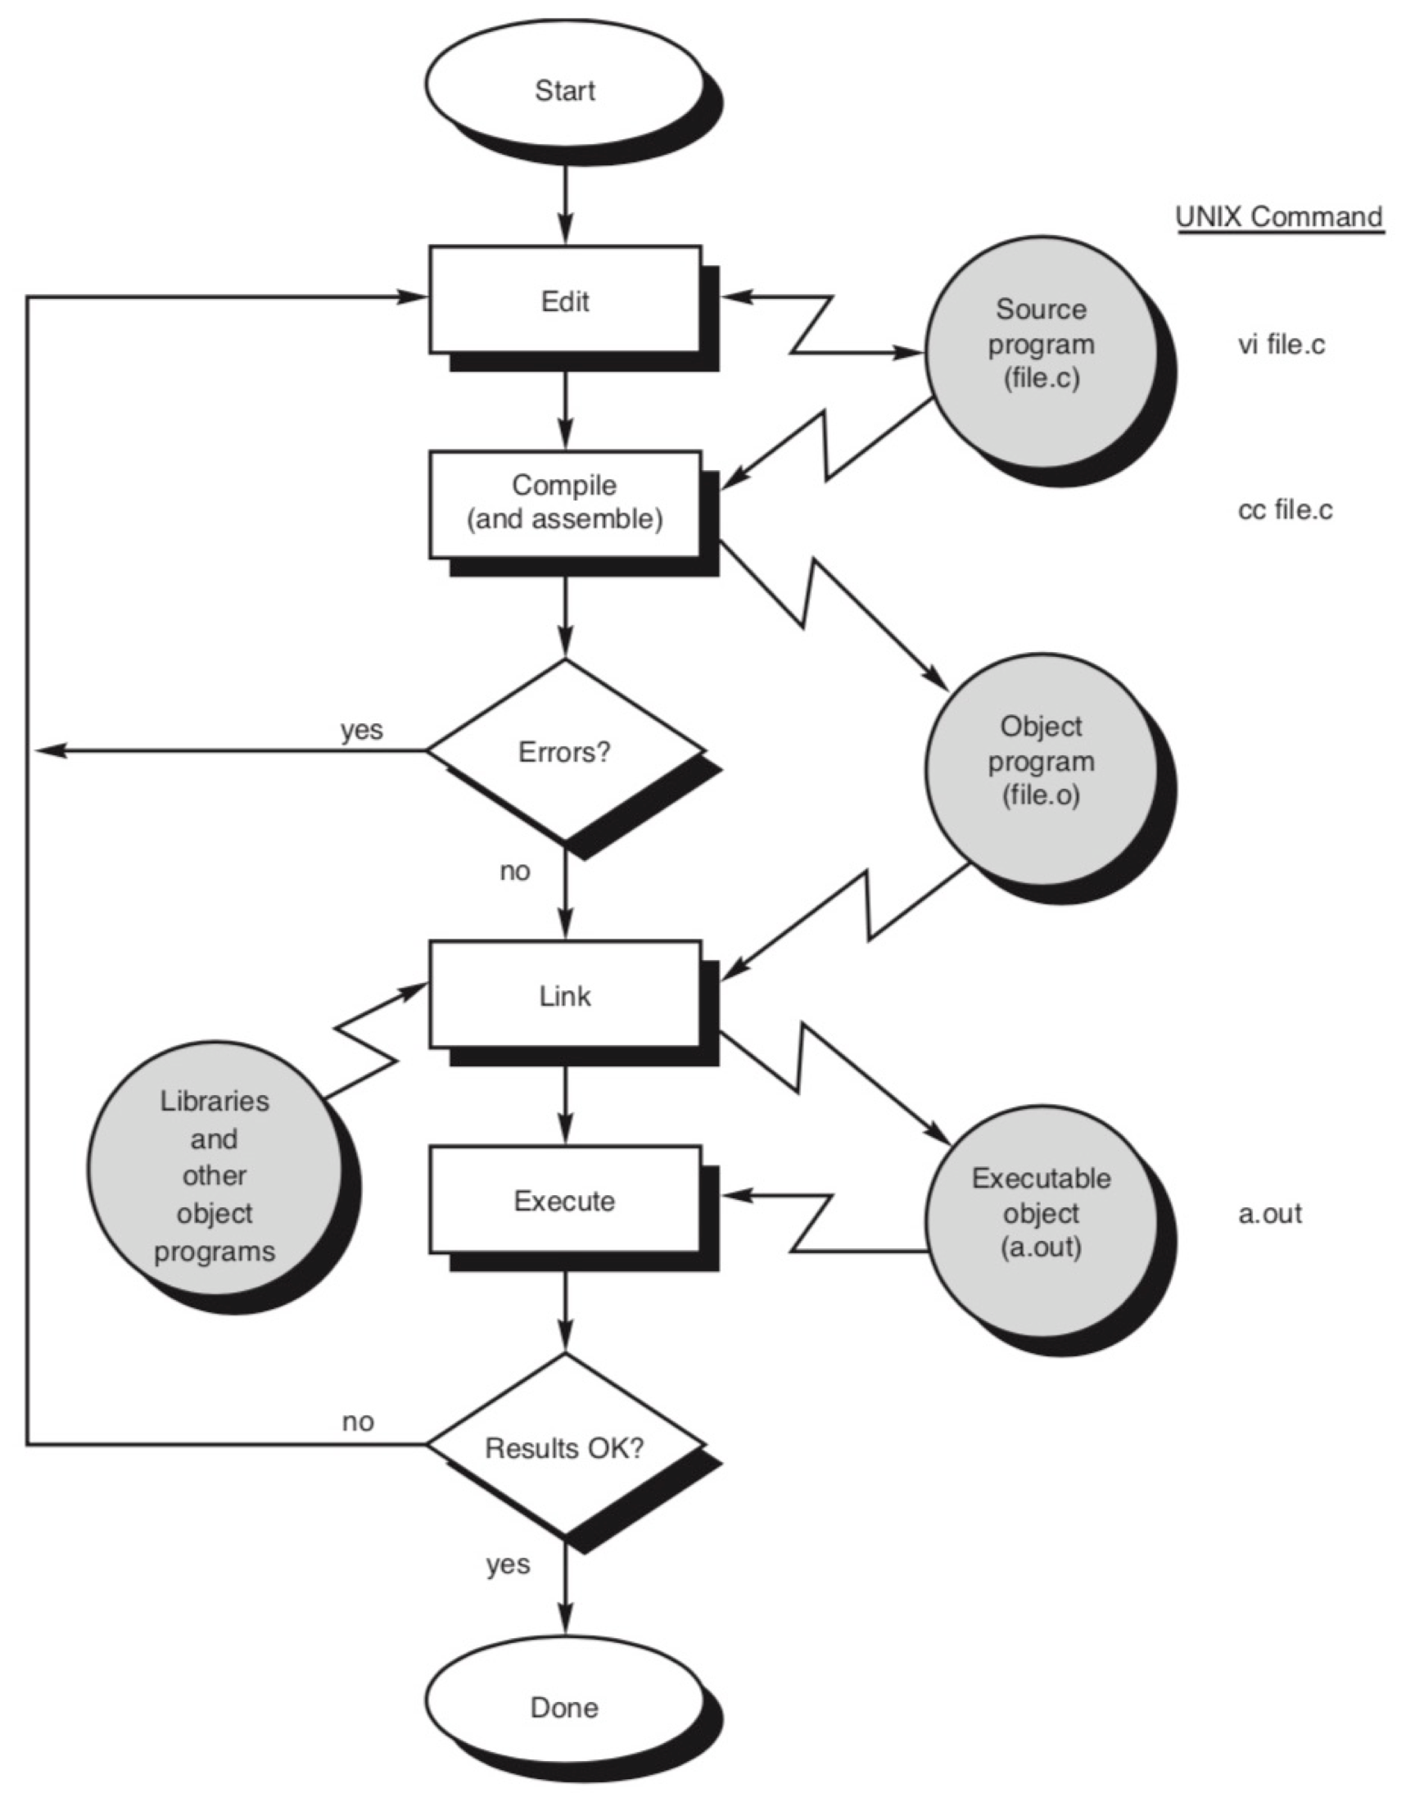

Slide 30
Practical Exercises
Write and Compile the following C programs:
Program 1:

Slide 31
Practical Exercises
Write and Compile the following C programs:
Program 2:

Slide 32
Practical Exercises
Write and Compile the following C programs:
Program 3:

Slide 33
Practical Exercises
Write and Compile the following C programs:
Program 4:

